Slide 1
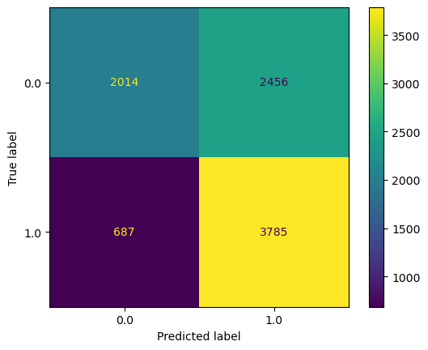
Executive Summary: Regression Analysis
TikTok Claims Classification Project
Earlier, the data team observed that verified users are much more likely to post opinions. Since the end goal is to classify claims and opinions with a claims classification model, it’s important to build a model that shows how to predict the behavior of the verified account type that tends to post more opinions. Hence, the data team built a logistic regression model to predict categories of verified_status.
The team selected a logistic regression model that makes predictions based on a video’s duration, view count, transcription text length, claim status and author ban status.
MODEL RESULTS
The logistic regression model achieved a precision of 60.6%, a recall of 84.6%, and an accuracy of 64.9%, suggesting the model’s tendency to predict unverified accounts as verified ones. These results also inform key insights on video features that predict an author’s verified status.
From the estimated model coefficients from, longer videos with longer transcription texts, are associated with higher odds of the user being verified.
Other video features have estimated coefficients of almost zero in the model, suggesting negligible connections with an user’s verified status.
Confusion matrix for logistic regression model
The next step is to construct a classification model that will predict the status of claims, which is the final project. Now, there is enough information to analyze the results of that model with helpful context around user behavior.
Upper-left: accurate predictions of videos posted by unverified accounts. Upper-right: inaccurate predictions of videos posted by unverified accounts. Lower-left: inaccurate predictions of videos posted by verified accounts. Lower-right: accurate predictions of videos posted by unverified accounts.

